Slide 1
Real-time machine learning detection of Heart Failure using big data approach

Slide 2
ABSTRACT:
According to recent survey by UN agency (World health organization) seventeen.9 million individuals die annually owing to heart connected diseases and it's increasing chop-chop. With the increasing population and illness, it's become a challenge to diagnosis illness and providing the suitable treatment at the proper time. however, there's a light-weight of hope that recent advances in technology have accelerated the general public health sector by developing advanced useful medical specialty solutions.At analysing the assorted datamining techniques particularly Naive Bayes, Random Forest Classification, Support Vector Machine by employing a qualified dataset for cardiopathy prediction that is include varied attributes like gender, age, hurting sort, pressure level, blood glucose etc.

Slide 3
OBJECTIVES
The main objective of this study is to predict weather a patient is affected with cardiopathy or not exploitation totally different machine learning algorithms on a certified dataset. conclude the correlations between totally different attributes. getting clear plan of our projected data processing techniques and analyze the result and scrutiny between the results of various data processing techniques. we are going to analyze our techniques if there's any chance to bring improvement for our results.

Slide 4
Existing System
Remote mobile health monitoring has already been recognized as not only a potential. Each stage such as data aggregation, data maintenance, data integration, and data analysis, and pattern interpretation, application faces many challenges while dealing with healthcare big data (HBD). There are many problems in complexity of analysis and scalable of data in parallelization computing model is processed. They have not accuracy in prediction of heart disease.

Slide 5
LIMITATION
Certain approaches being applicable only for small data.
Certain combination of classifier over fit with data set while others are under fit.
Some approaches are not adoptable for real time collection of database implementation.

Slide 6
Proposed System
In our project, proposed system is accuracy prediction of heart disease problem in health care application. Easier to analyse the scalable of health care big data. Less time consumption with efficiency of data in heart disease. High performance in data maintained of heart disease prediction.

Slide 7
ADVANTAGES
the performance classification of heart based diseases is further improved.
Time complexity and accuracy can have measured by various machine learning models, so that we can measures different.
Different machine learning having high accuracy of result.
Risky factors can be predicted early by machine learning models.

Slide 8
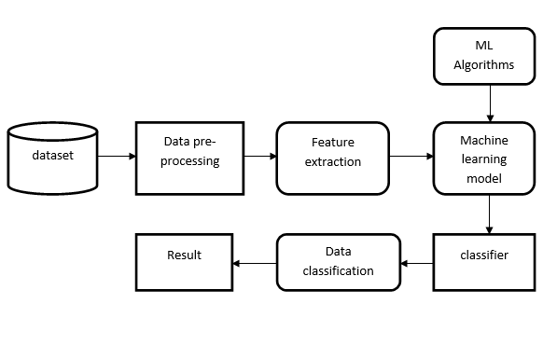
BLOCK DIAGRAM

Slide 9
SYSTEM REQUIREMENTS
Hardware:
Windows 7,8,10 64 bit
RAM 4GB
Software:
Anaconda Navigator
Pandas
Numpy
Sklearn
seaborn
matplotlib

Slide 10
Conclusion
In this research we have tried to compare different machine learning algorithms and predict if a certain person, given various personal characteristics and symptoms, will get heart disease or not. The main motive of our report was to comparing the accuracy . We have used dataset for heart diseases which contains 303 instances where we divide the data into two sections which are training and testing datasets. We have considered 13 attributes and implemented four different algorithms to analyze the accuracy. By the end of the implementation part, we have found Gaussian Naïve Bayes and Random Fore stare giving the maximum accuracy level in our dataset which is 91.21 percent and ANN is performing with the of accuracy of 81.96 %

